Slide 1

Social Network Analysis of
NYC Jobs Post
Instructor: Feng Mai
Member: Bowen Lu, Zihan Chen, Jingmiao Shen, Yuan Zhou

Slide 2
Agenda
1. Background
2. Exploratory Data Analysis
3. Network Analysis

Slide 3
Background

Slide 4
For Job Seekers
Our work could help them to choose several skills they should learn and to understand which skill is more important than others
For Hiring Companies
Our project can assist them in analyzing similarities between their jobs and the jobs from other companies and then they could adjust the strategy to attract the best talented employees.

Slide 5
Exploratory Data Analysis

Slide 6
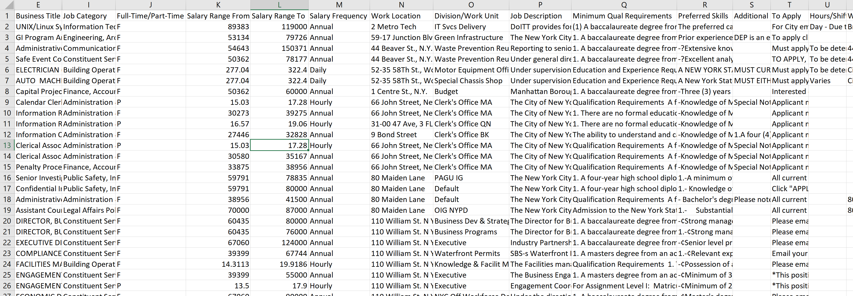
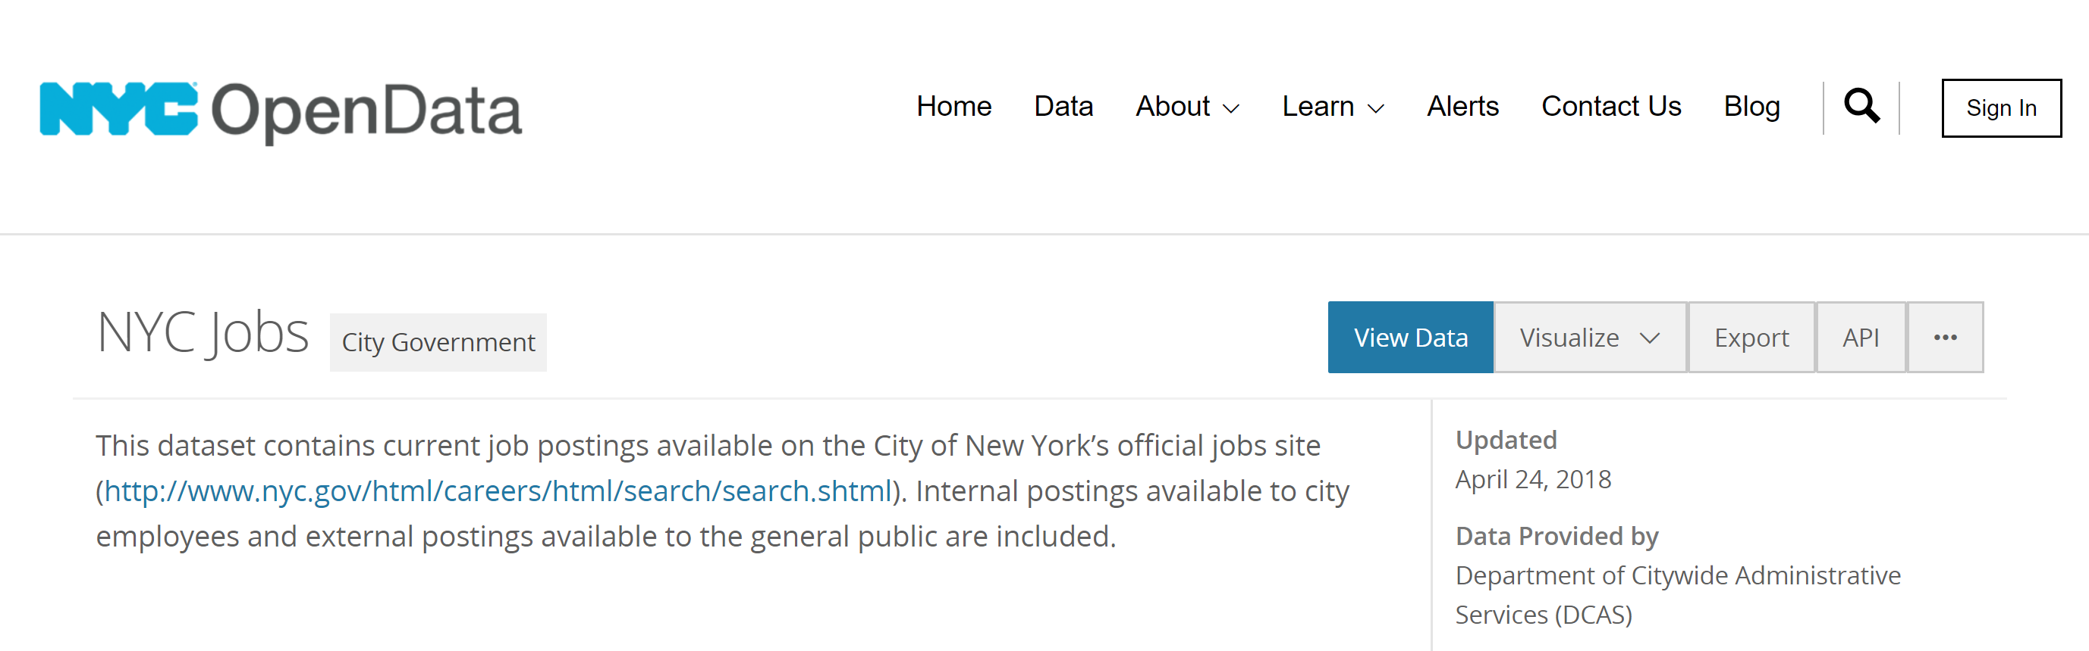
Data Source

Slide 7
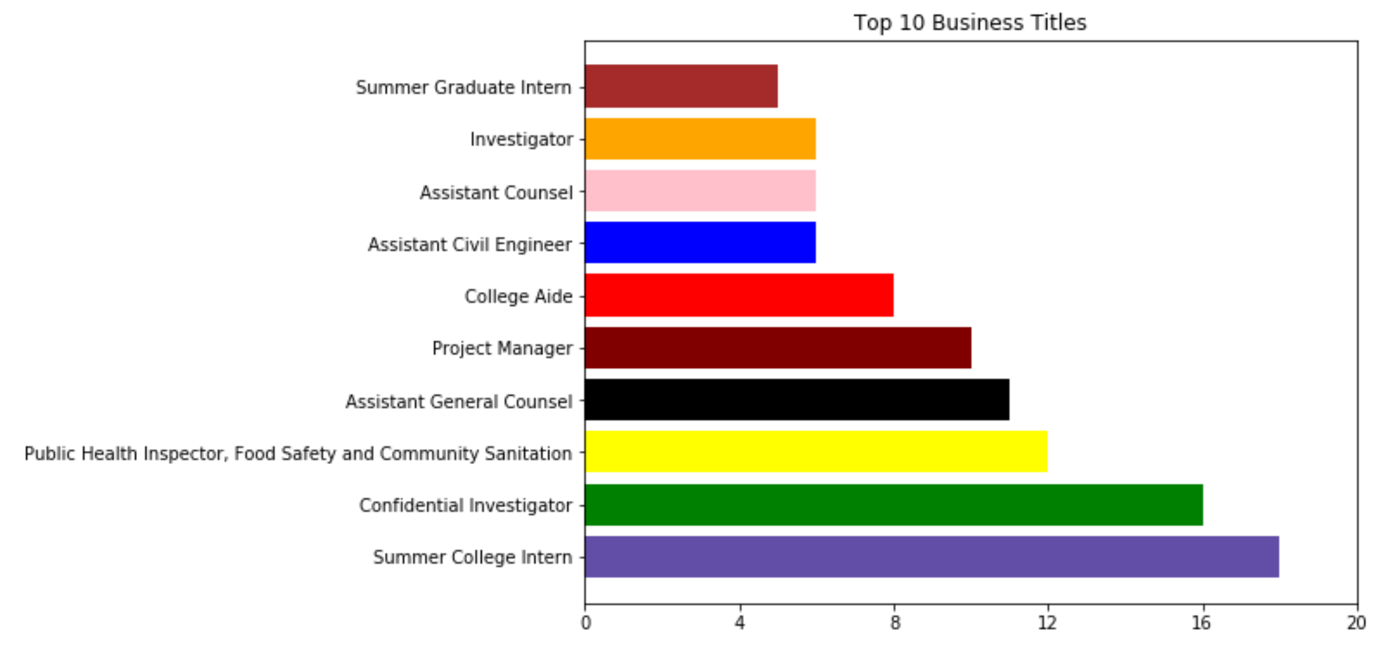
Top 10 Business Title

Slide 8
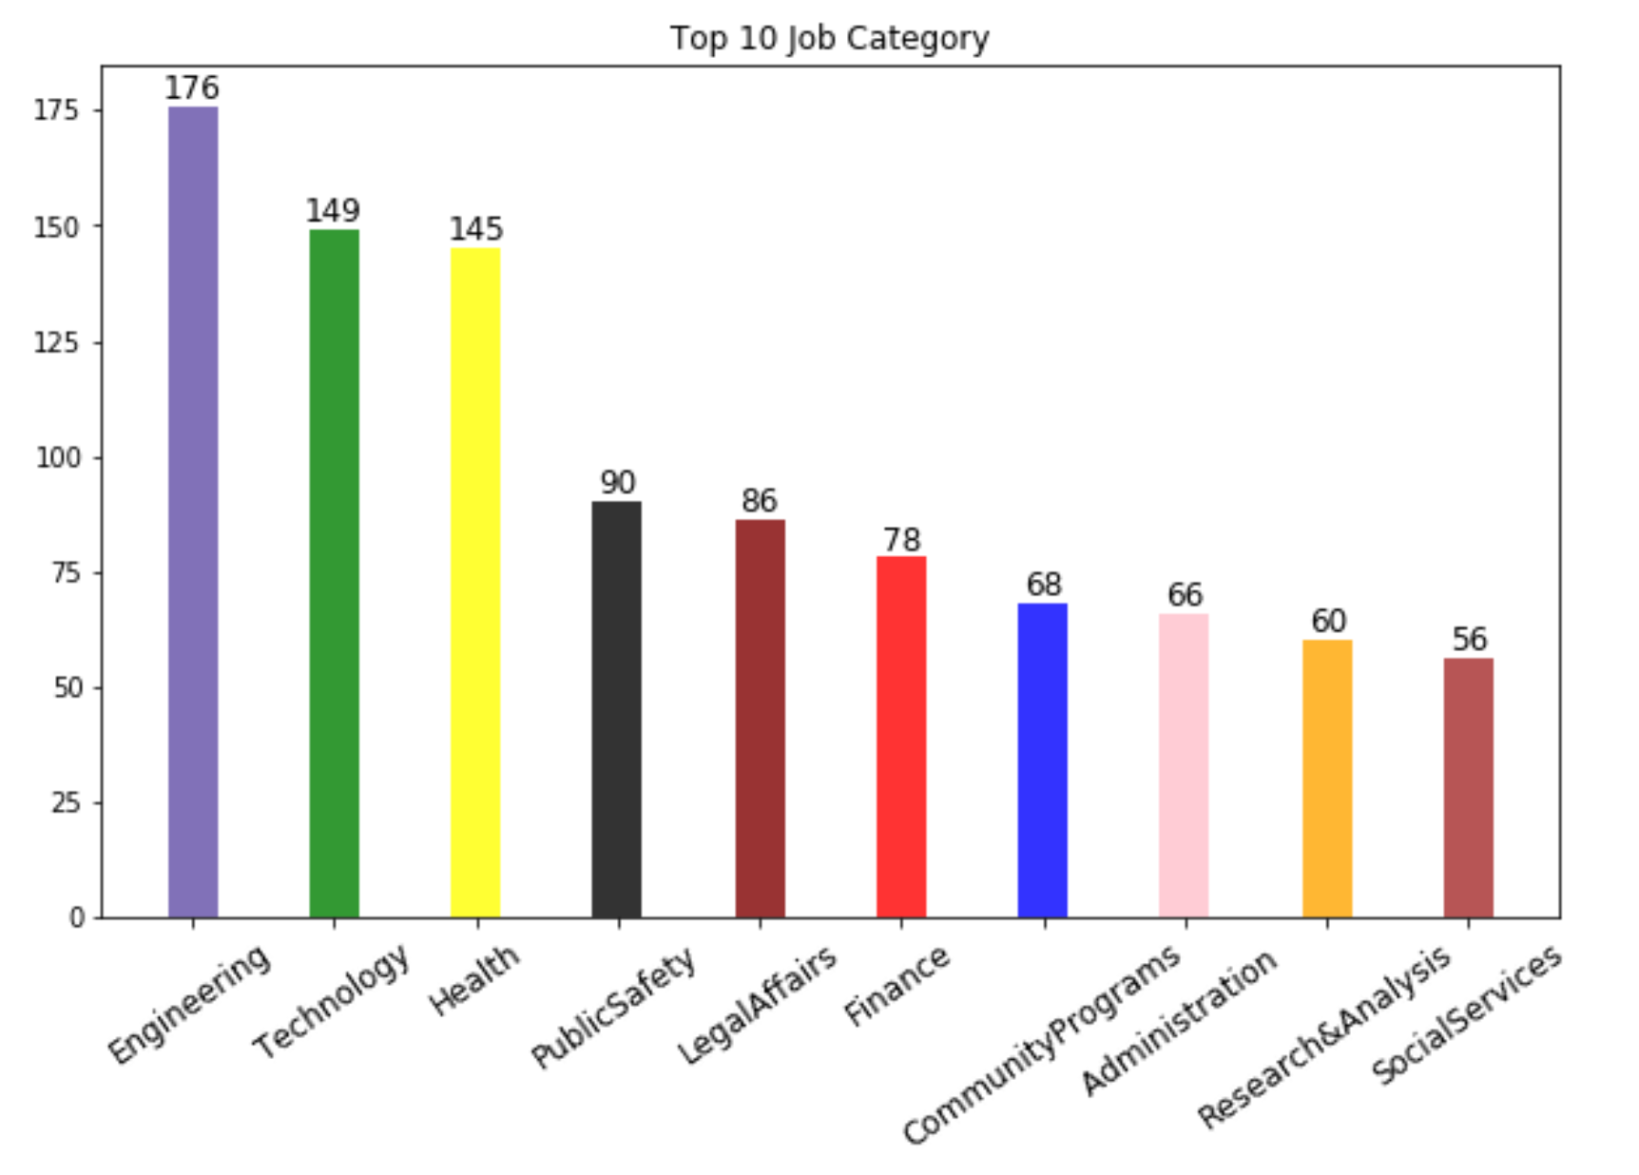
Top 10 Job Category

Slide 9
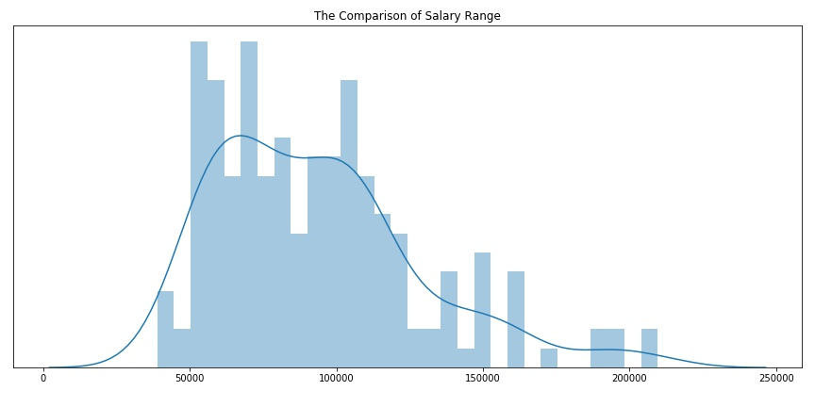
The Comparison of Salary Range
9

Slide 10
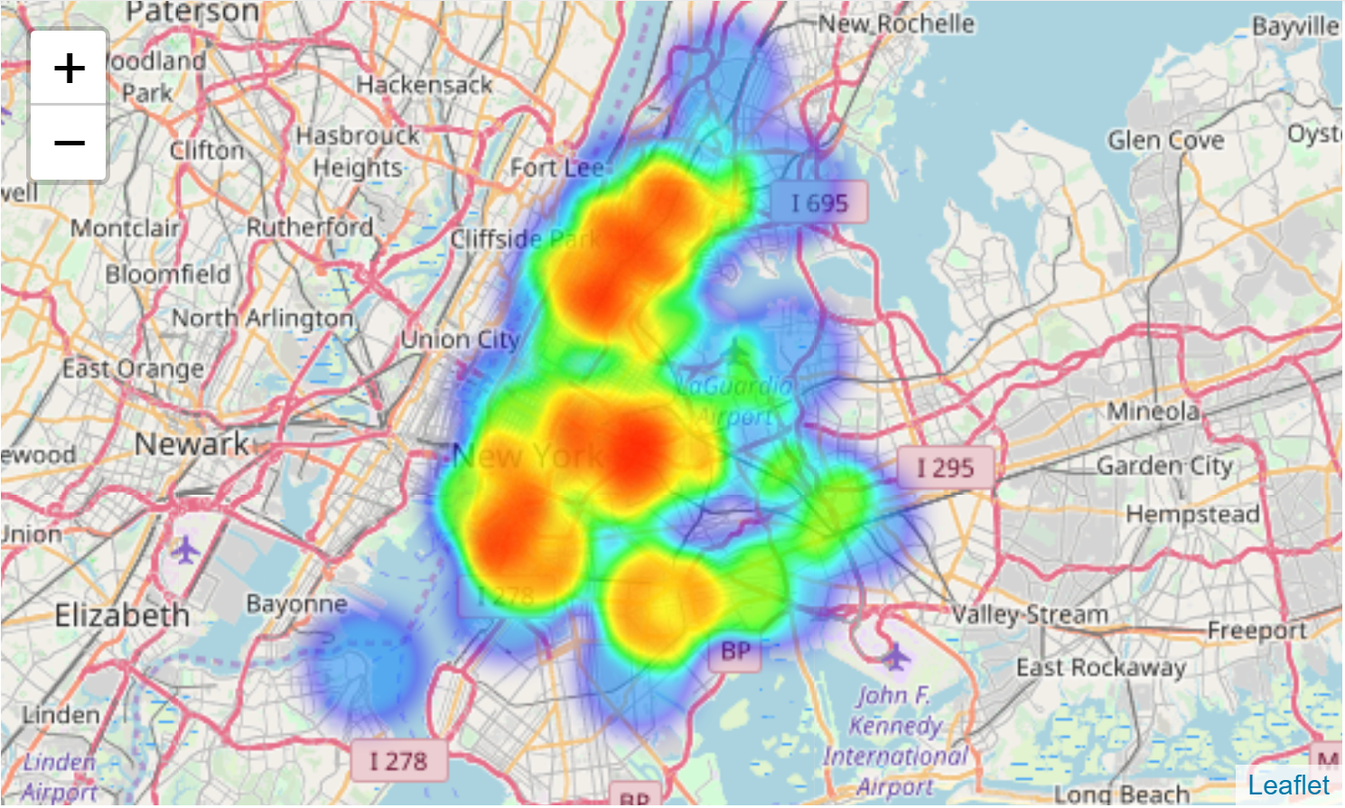
The Comparison of Work Location
10

Slide 11
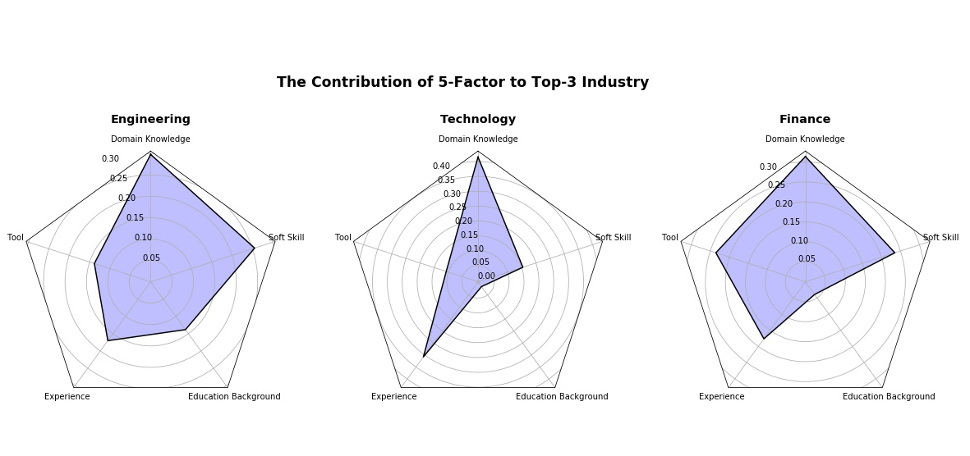
The Comparison of Requirement

Slide 12
Network Analysis

Slide 13
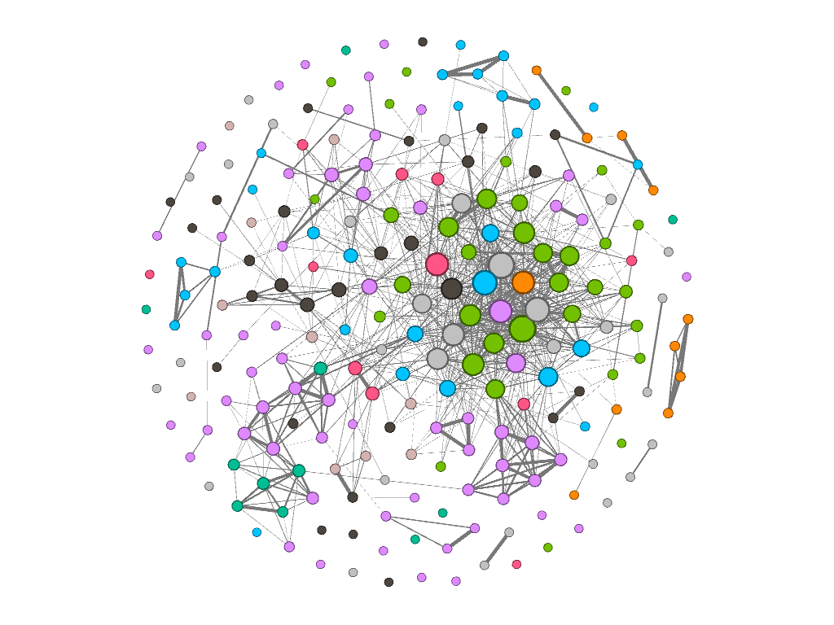
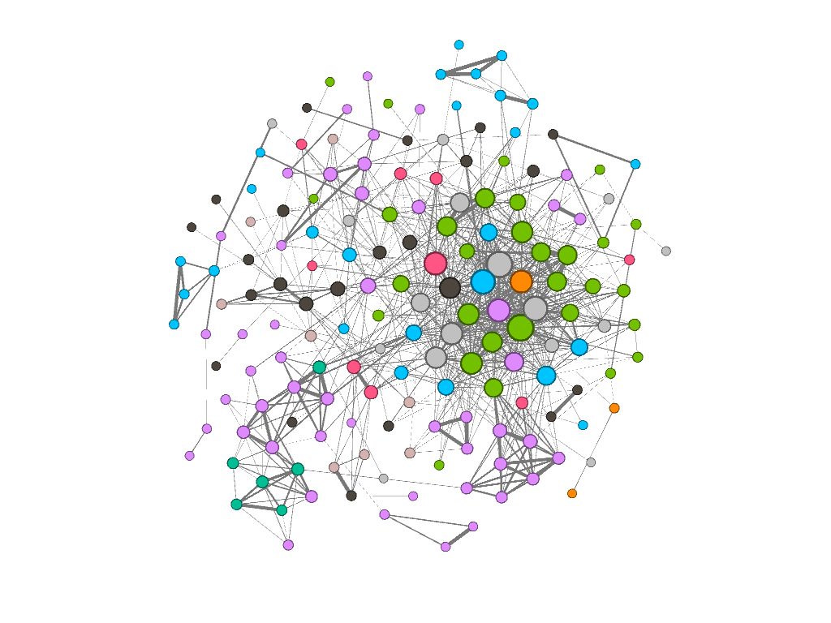
Overview
Nodes: Job position {Attri: Name, Agency, Category,…}
Links: cosine similarity of “Preferred Skills”
NLP: remove num&punctuation&stopwords, stem terms
Threshold: adj_matrix <- ifelse (cosine_sim>0.4, cosine_sim, 0)
V: 169
E: 913
V: 225
E: 927
13

Slide 14
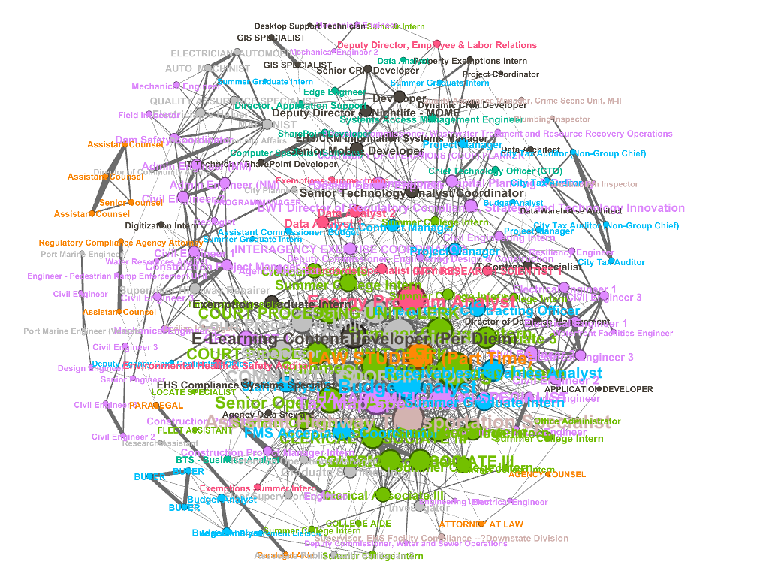
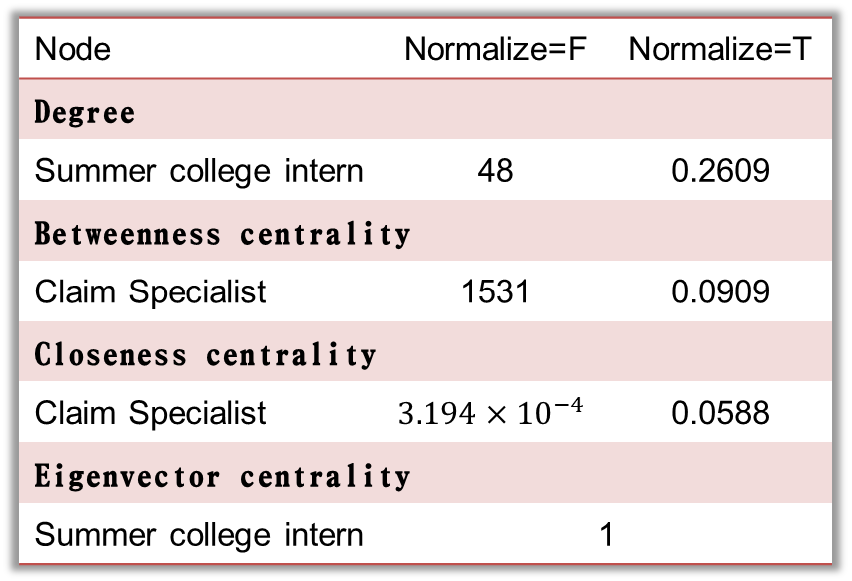
Degree centralization: 0.0747
Density: 0.0545
Transitivity: 0.4955
Homophily:
Assortativity of posting type (internal/external)
0.06745826
Assortativity of status (full-time/part-time)
-0.01530401
Assortativity of degree
0.2938687
Node | Normalize=F | Normalize=T
Degree
Summer college intern | 48 | 0.2609
Betweenness centrality
Claim Specialist | 1531 | 0.0909
Closeness centrality
Claim Specialist | $$3.194×{10}^{−4}$$ | 0.0588
Eigenvector centrality
Summer college intern | 1
14

Slide 15
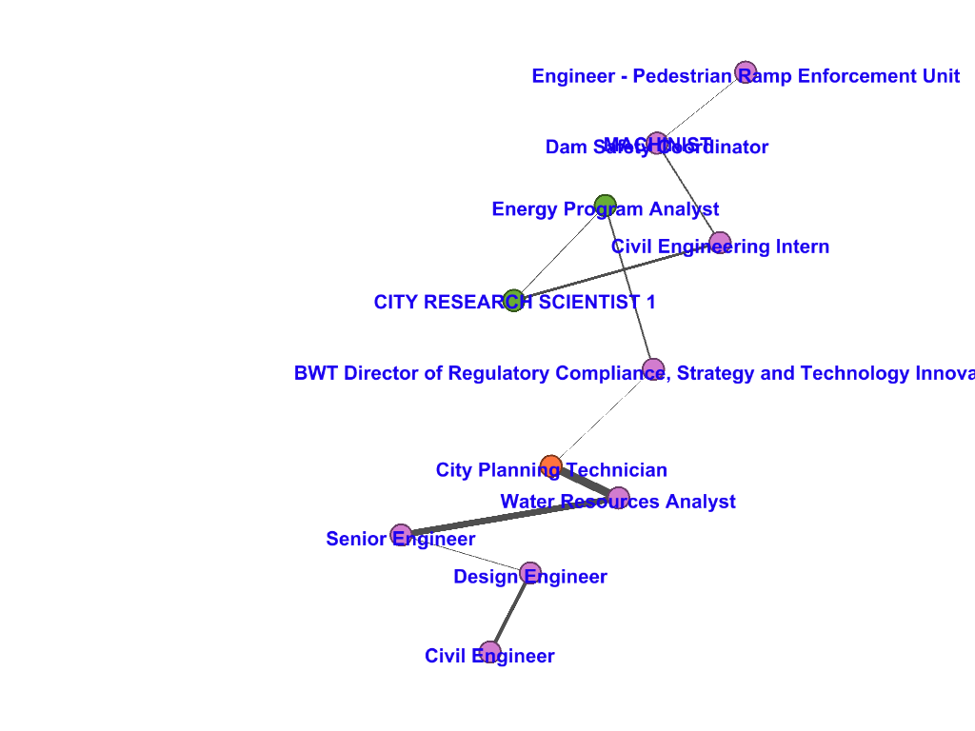
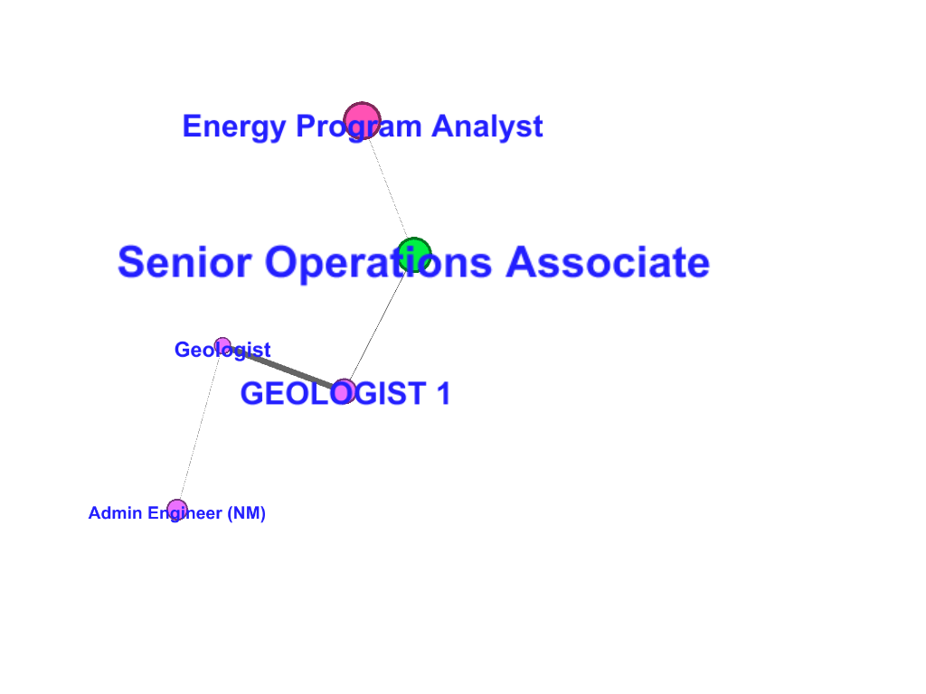
Distance & Diameter
Distance = 2.1165
Diameter = 5.6059

Slide 16
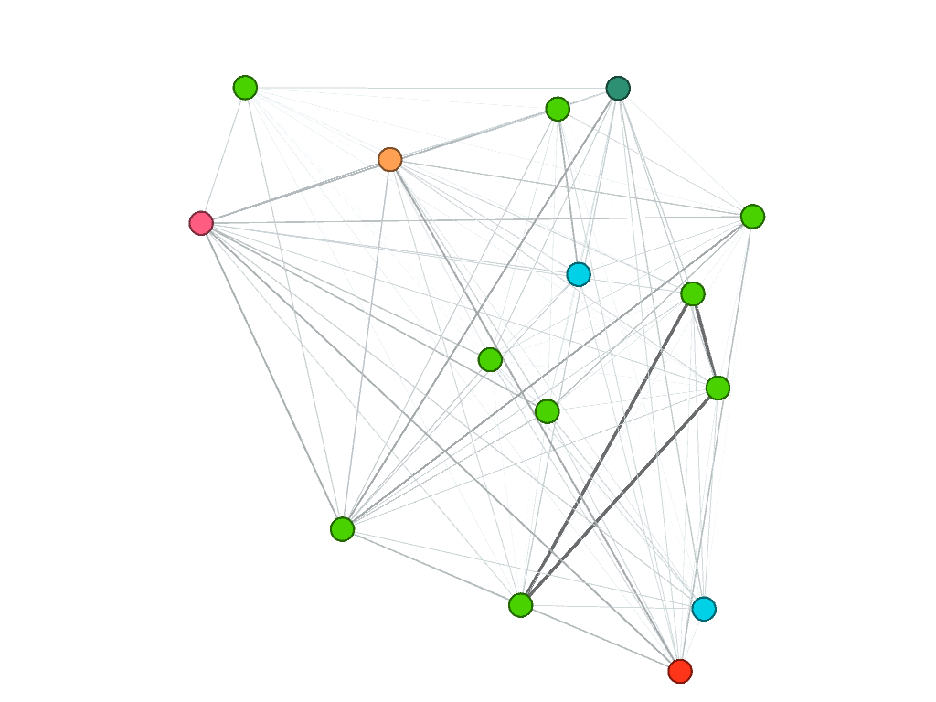
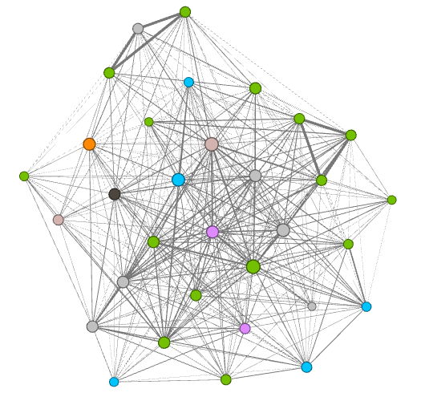
Cliques vs. K-core
Degree (node) = 14
Degree (node) ≥ 14
V=15, E=105
V=32, E=352

Slide 17
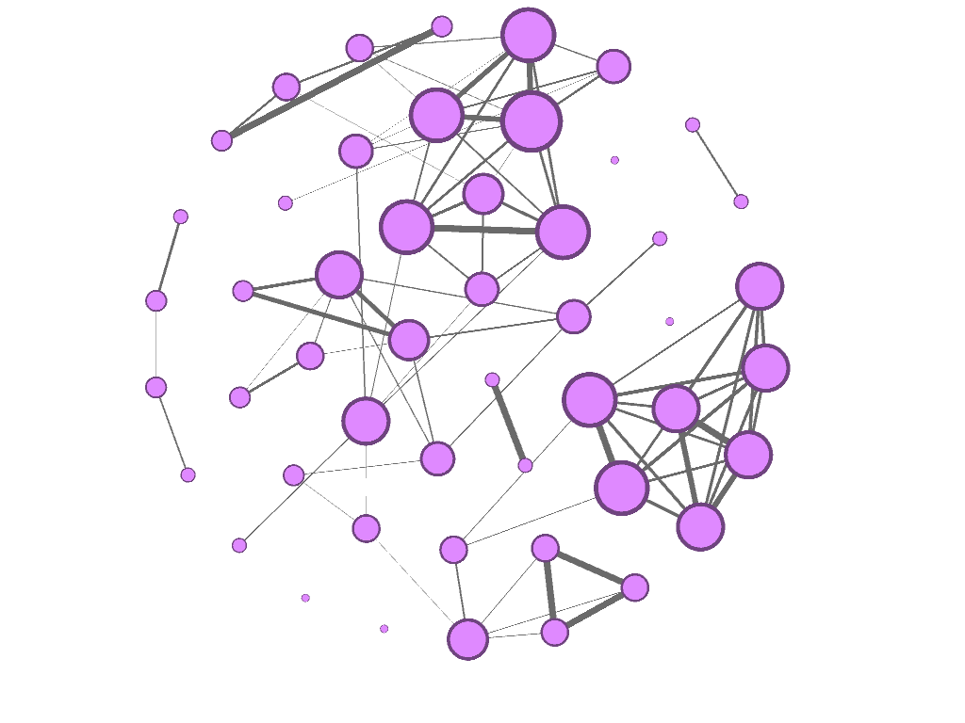
Detail View
A: Single field (e.g. Engineering, Architecture & Planning)
Hub
Node with high degree
Subnetworks
Any node and edge
Bridge
Endpoint lie in different components
17

Slide 18
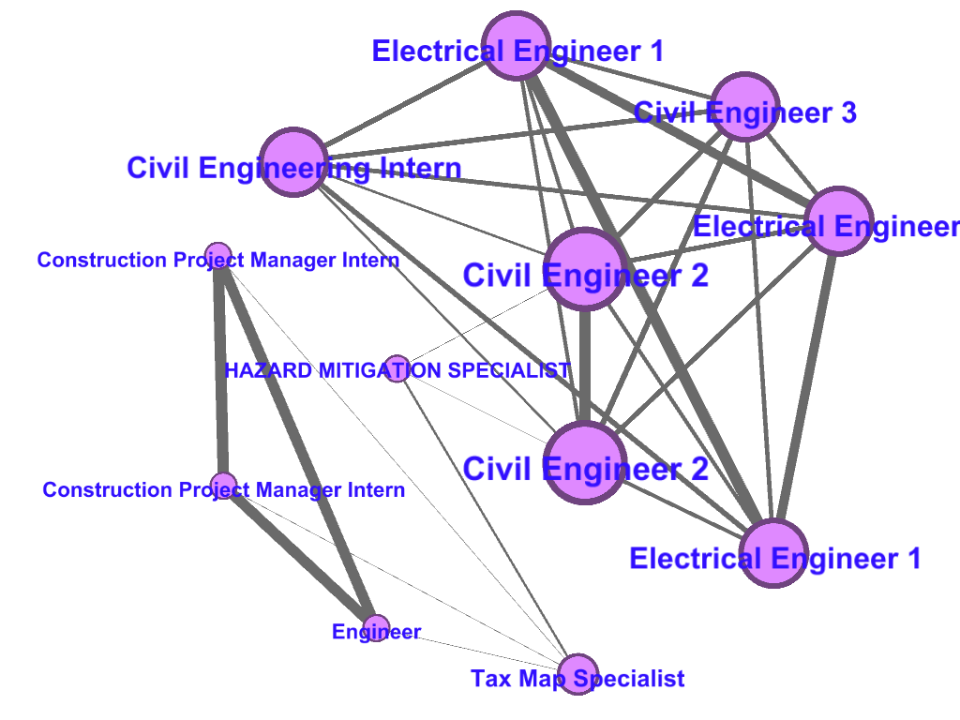
Subnetwork
A: Single field (e.g. Engineering, Architecture & Planning)
Shortest path
Practicality
18

Slide 19
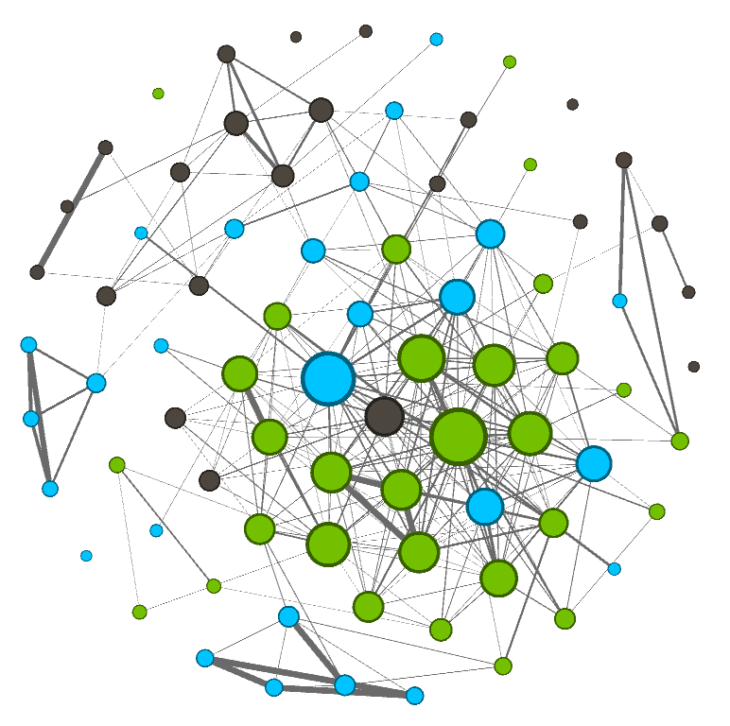
Detail View
B: Cross field
Administration & HR
Finance, Accounting & Procurement
Technology, Data & Innovation
19

Slide 20
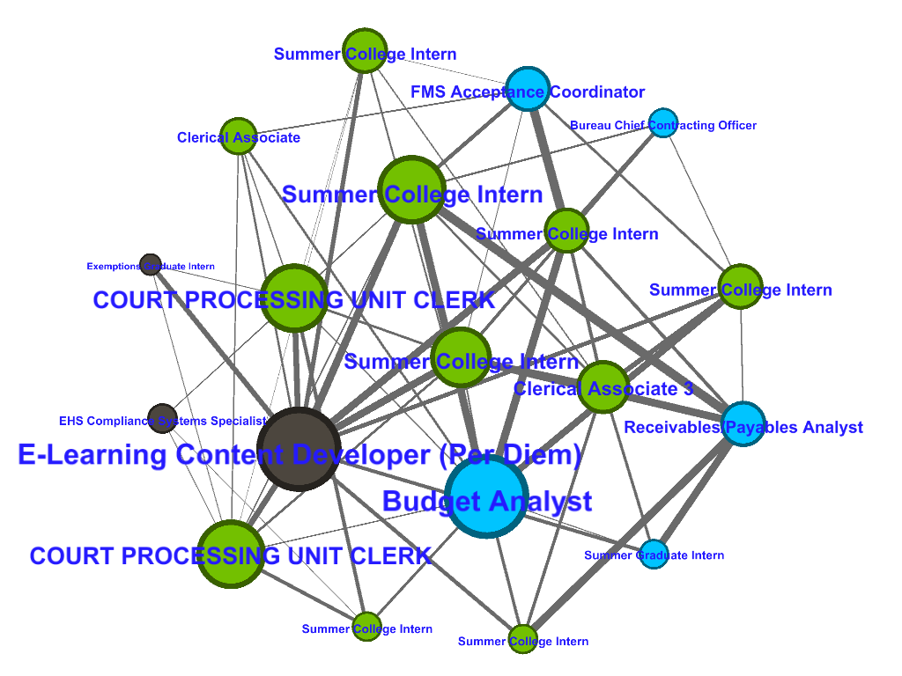
Subnetwork
B: Cross field (restricted to specific companies)
Dept of Finance
Dept of Environment Protection
Dept of Info & Telecom
20

Slide 21
Community Detection
1. Fruchterman-Reingold Layout
Edge Betweenness Community
Fastgreedy Community
2. Yifan Hu Layout

Slide 22
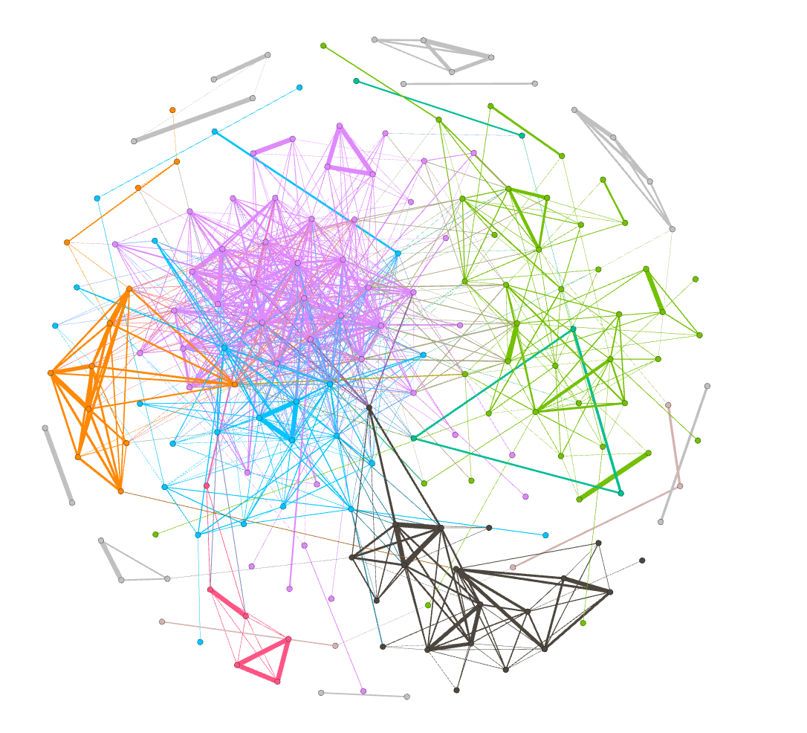
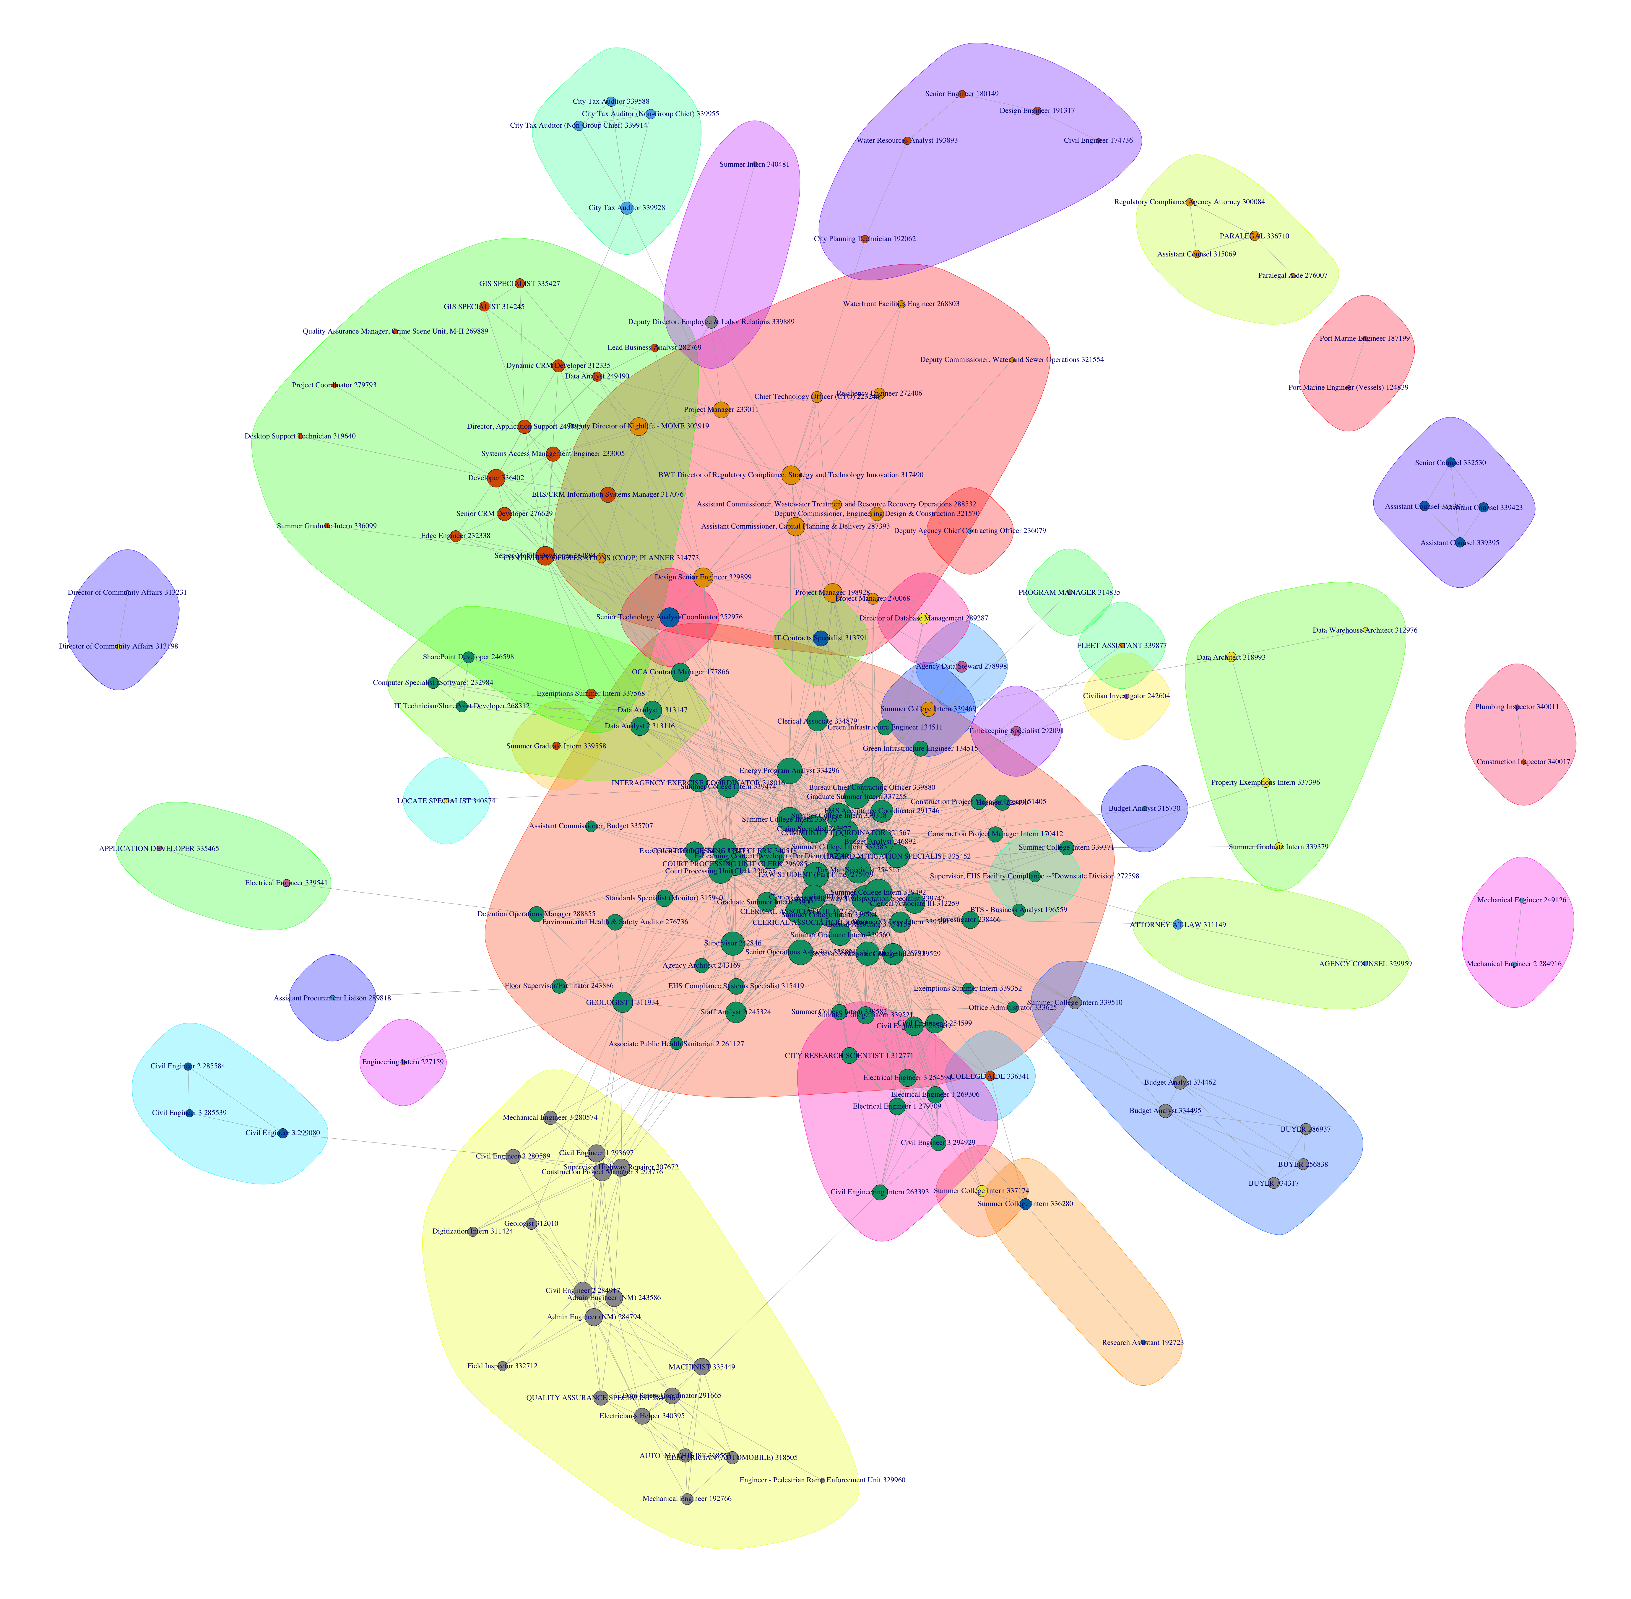
Community Detection

Slide 23
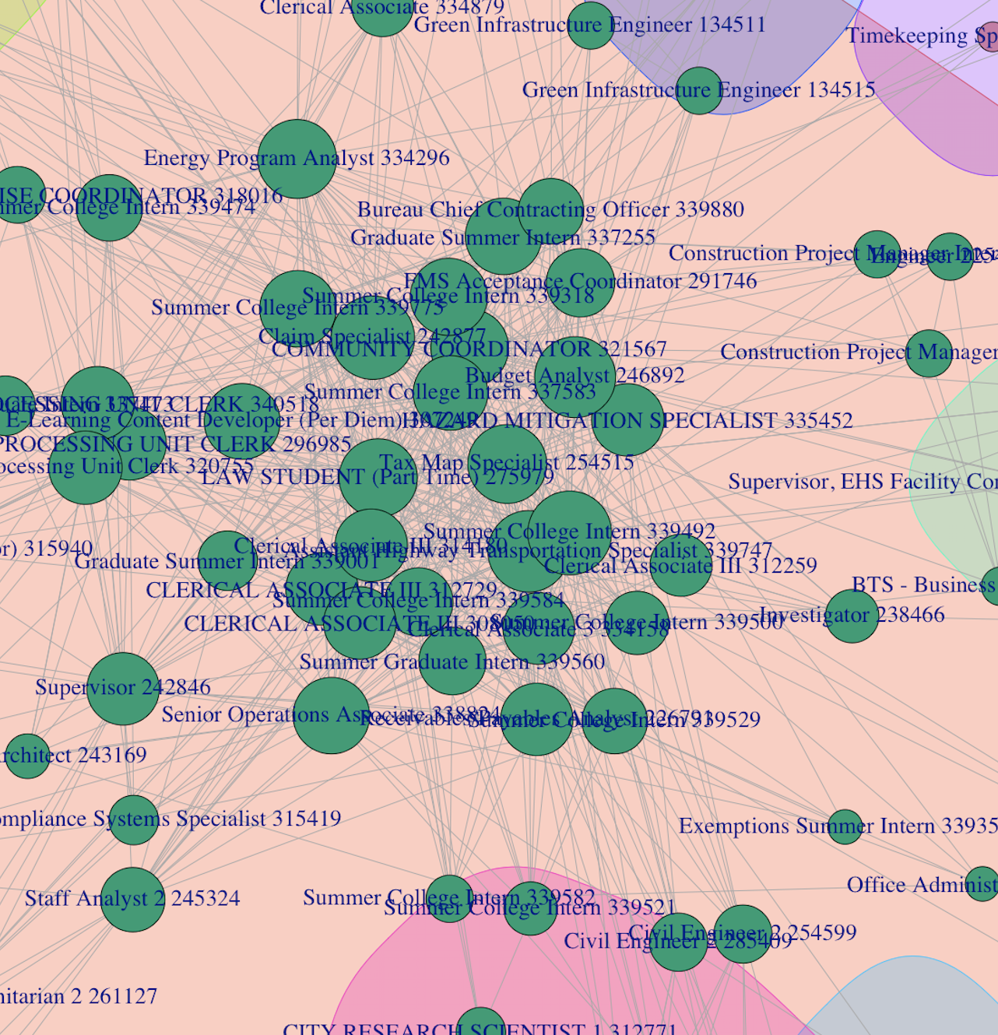
Community Detection

Slide 24
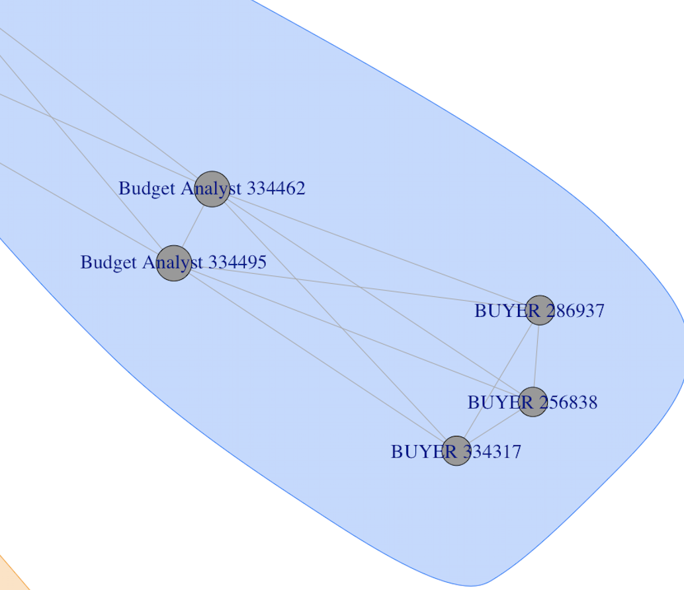
Community Detection

Slide 25
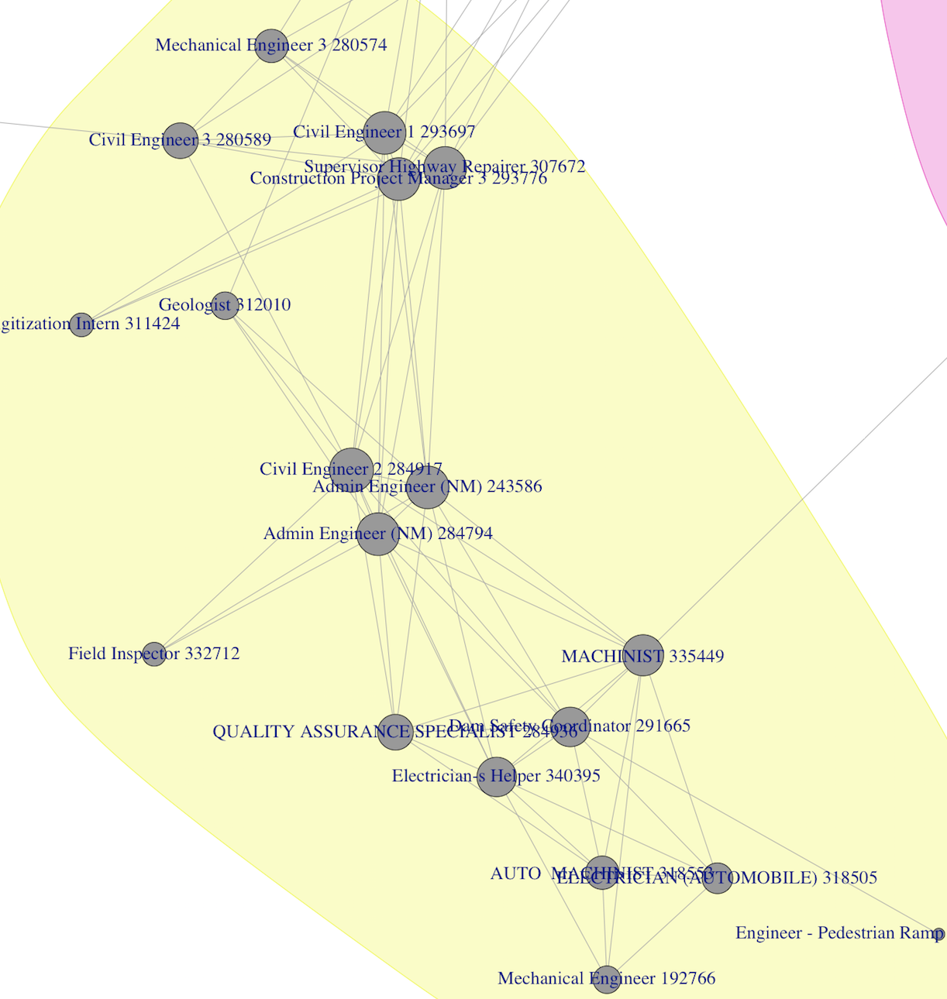
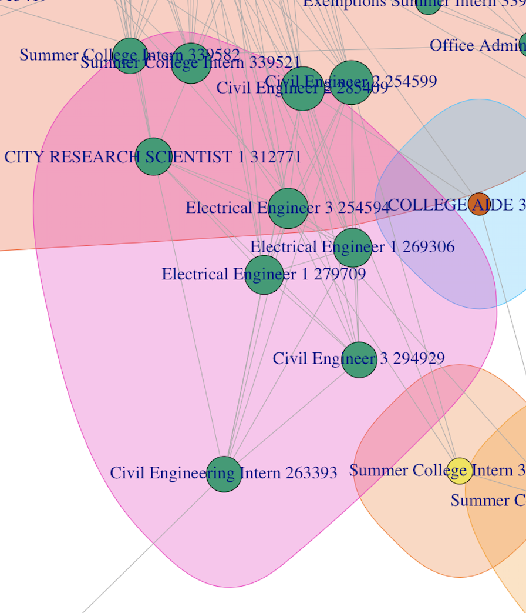
Community Detection

Slide 26
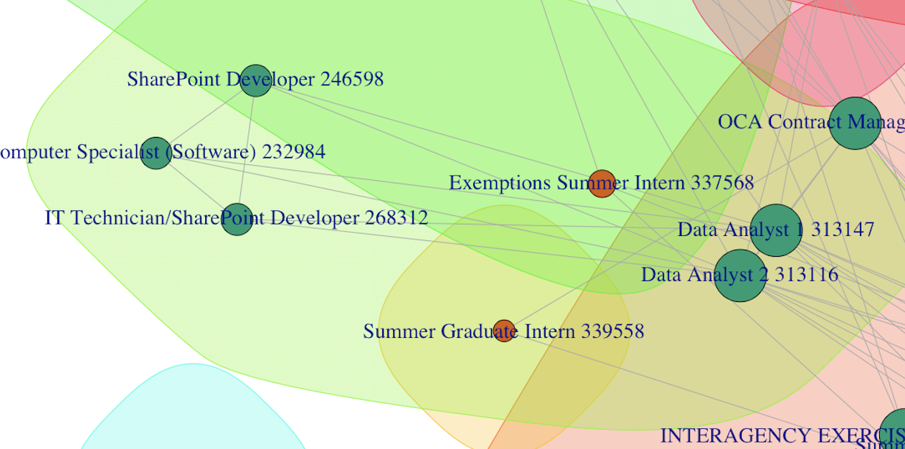
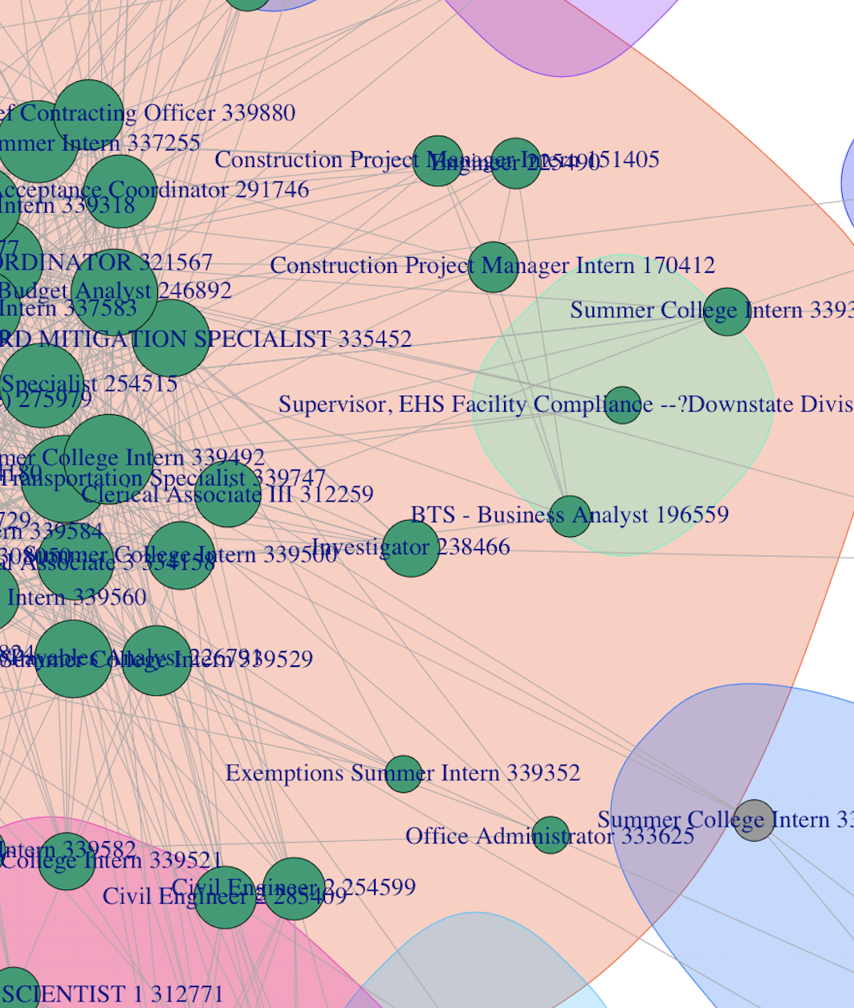
Community Detection

Slide 27
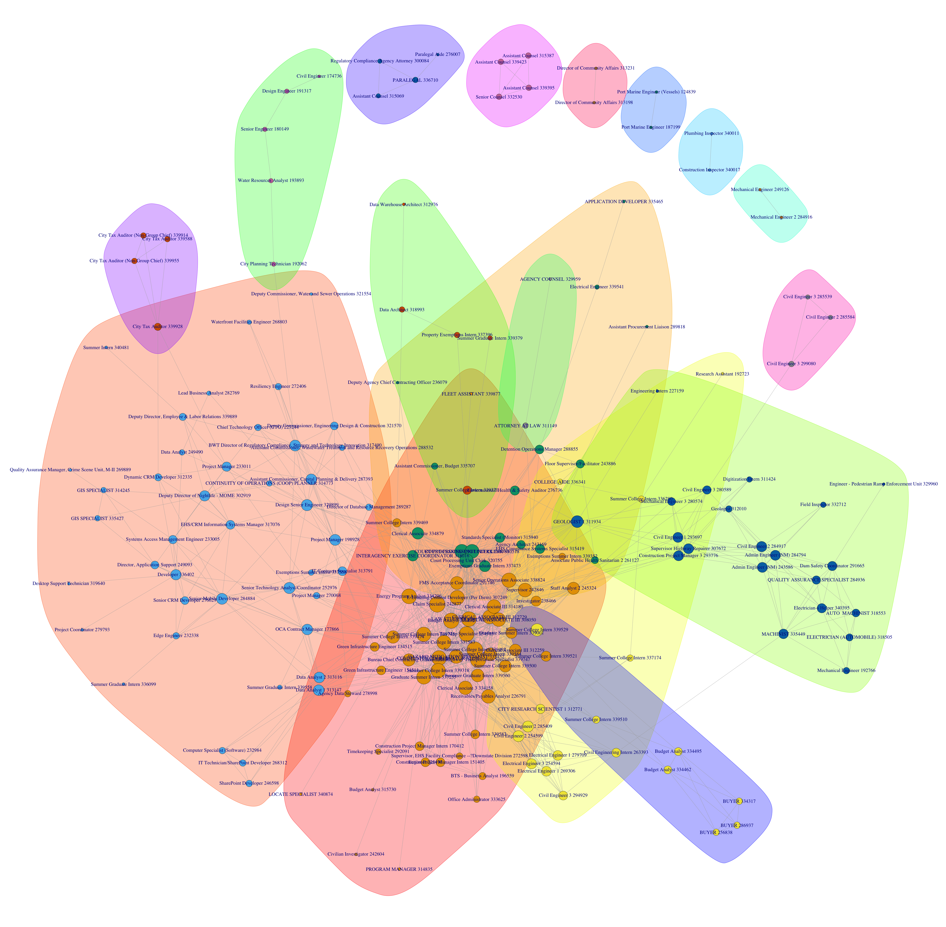
Community Detection

Slide 28
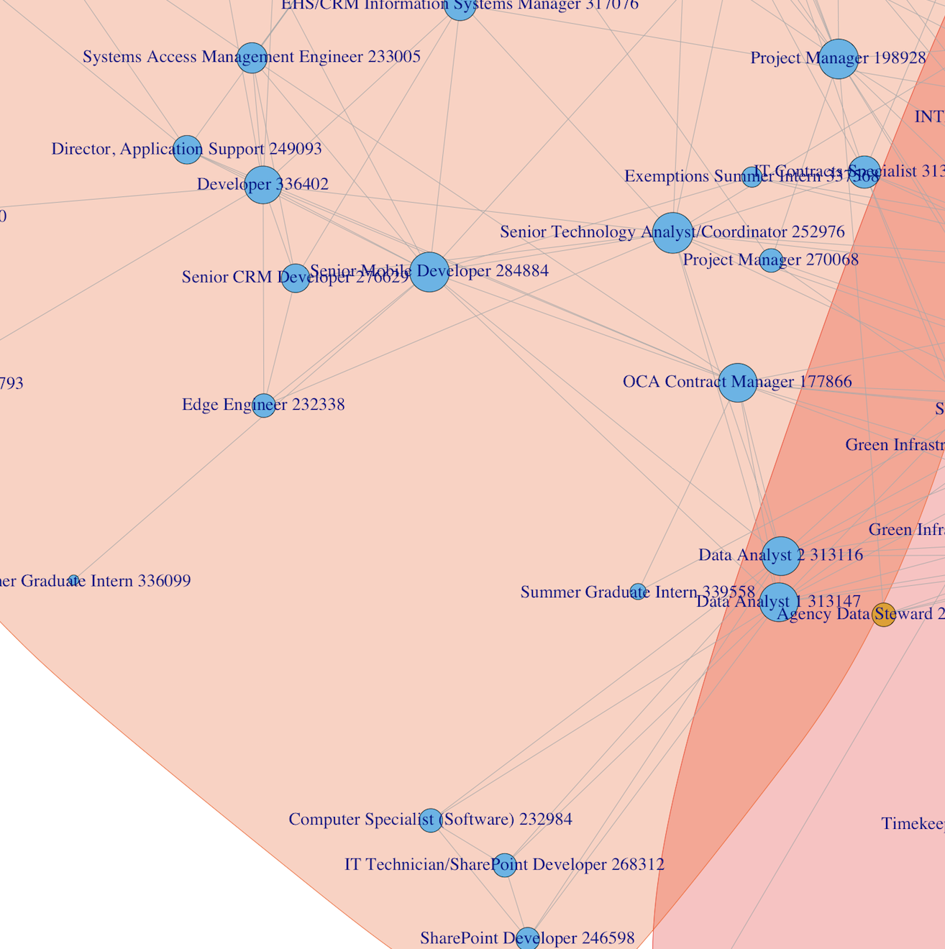
Community Detection

Slide 29
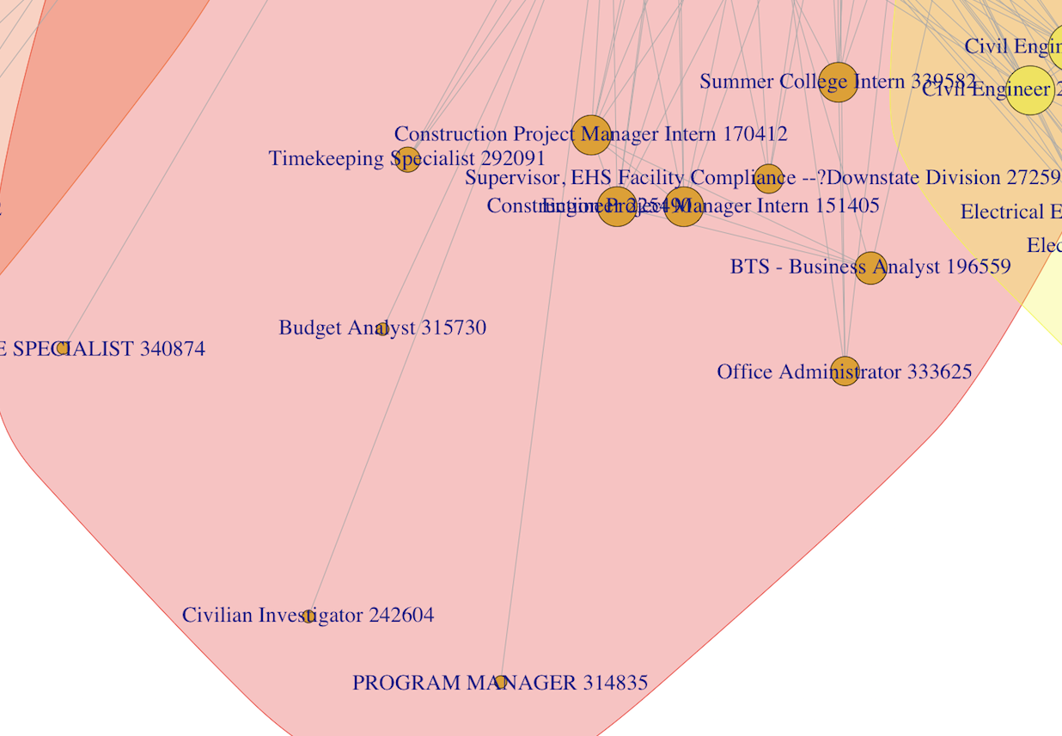
Community Detection

Slide 30
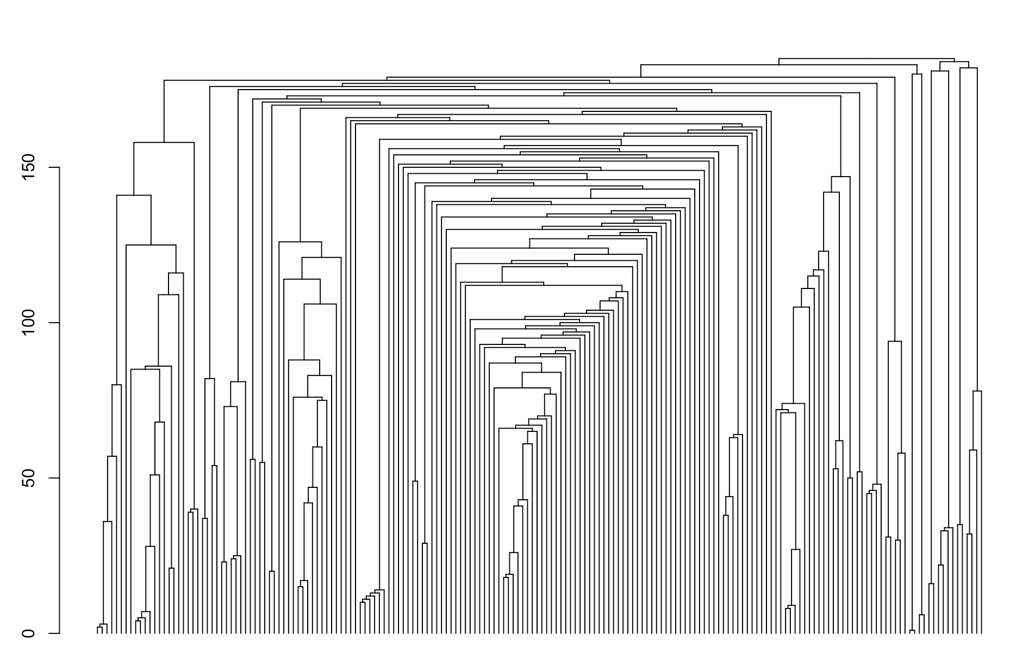
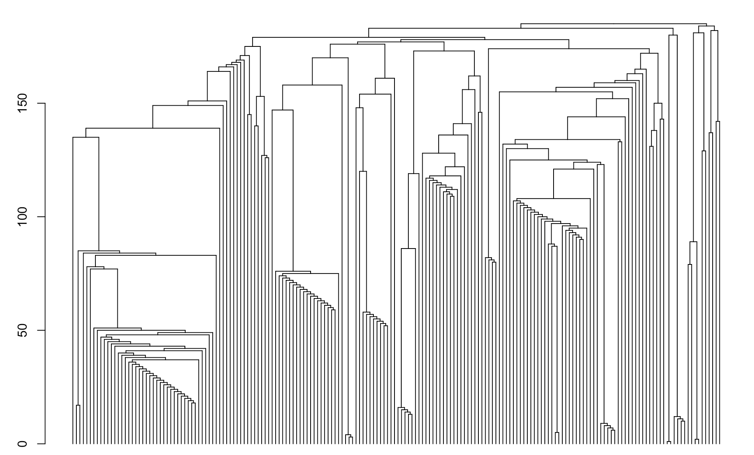
Community Detection
Edge Betweenness Community
Fastgreedy Community

Slide 31
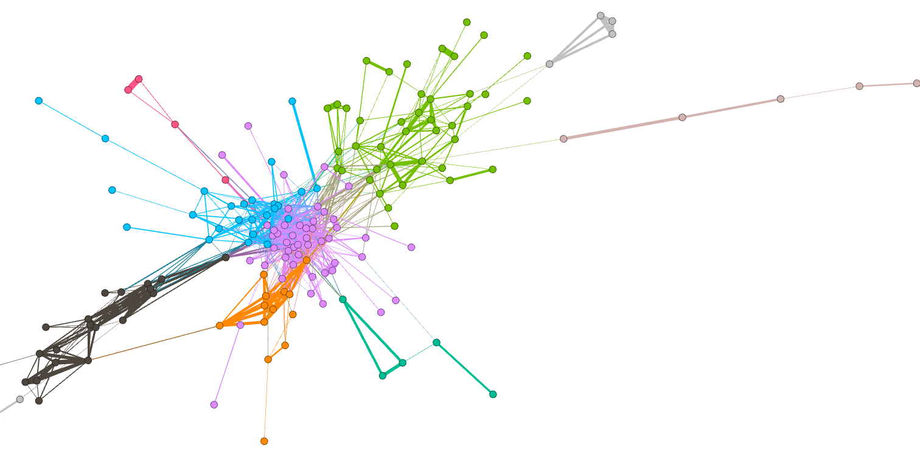
Community Detection

Slide 32
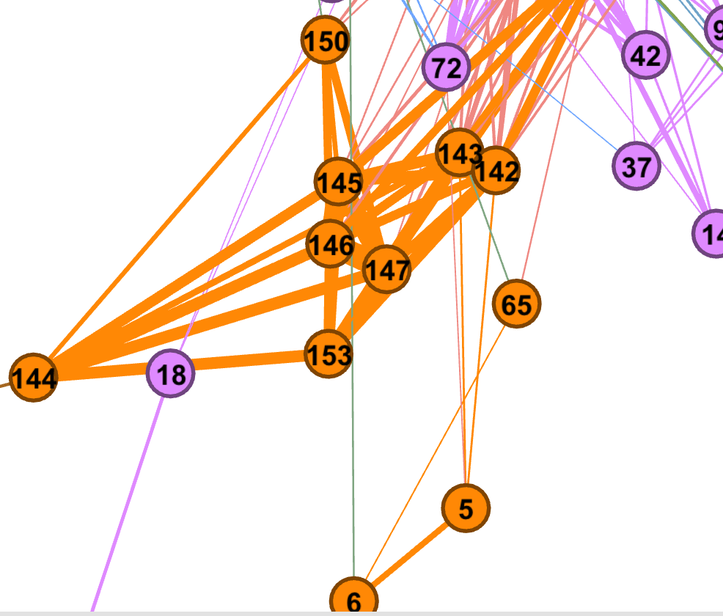
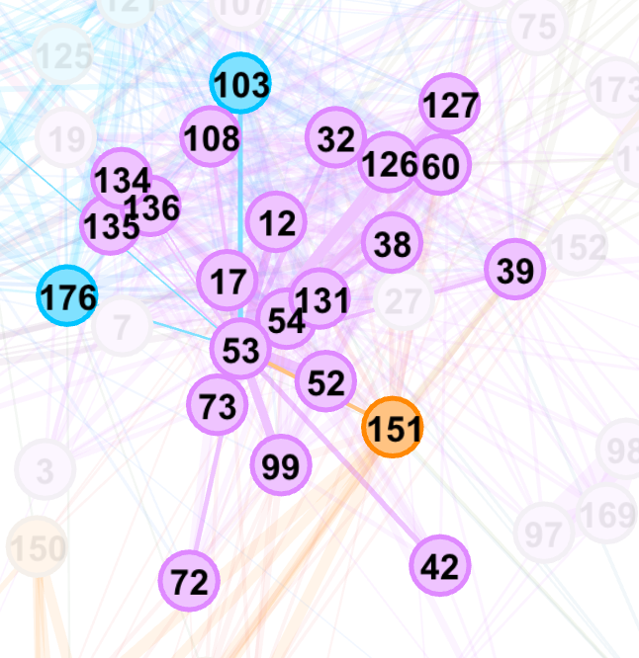
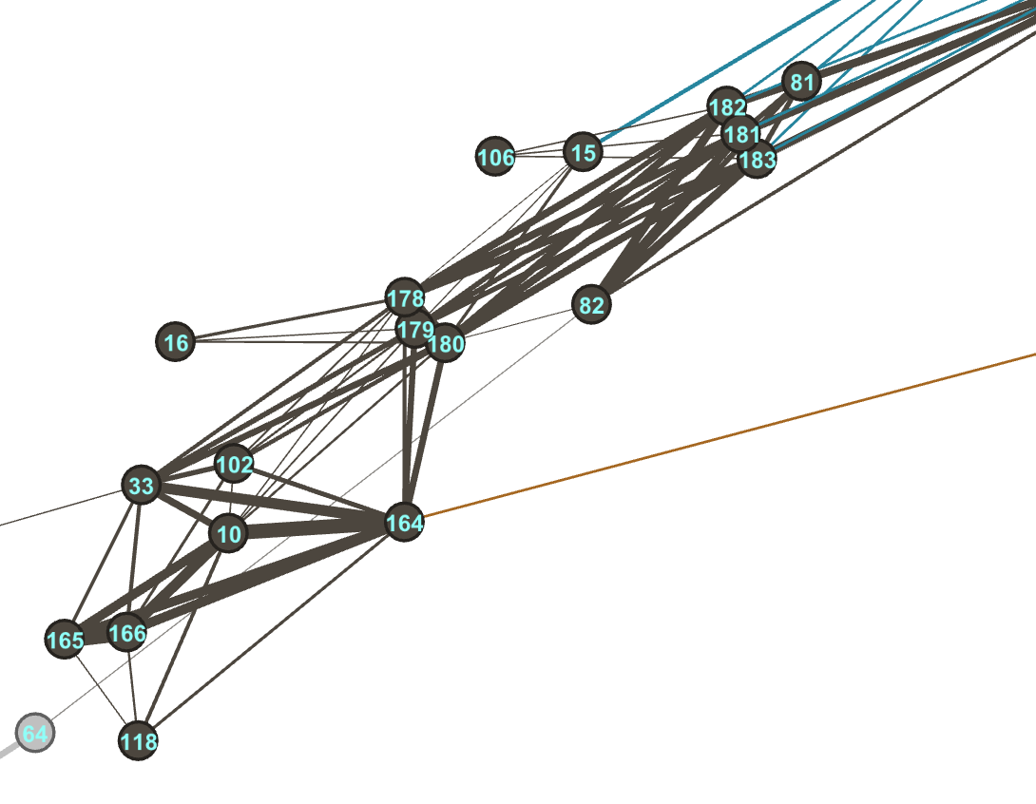
Community Detection

Slide 33
Community Detection
#Purple Points
College Intern
Summer College Intern
Summer College Intern
BTS - Business Analyst
Graduate Summer Intern
AGENCY COUNSEL
(DEPARTMENT OF FINANCE)
#Black Points
Civil Engineer
Civil Engineer
Civil Engineering Intern
Electrical Engineer
Electrical Engineer
Data AnalystOperational
Strategy Planner
（DEPT OF ENVIRONMENT PROTECTION，
DEPARTMENT OF TRANSPORTATION）
#Orange Points
BUYER
Budget Analyst
BUYER
Budget Analyst
Assistant Counsel
Vessel Construction Manager

Slide 34
THANK YOU

